Slide 1
Lectures - Exam - Decorum
45 hours (3 lectures/week, 14 – 15 weeks)
Grading: Assignment/Class Participation: 5
Test 01: 10
Test 02: 10
Quiz: 5
Case Study Writing 10
Final project/Project Proposal: 20
Final Exam: 40
Group List with Core Team
Business Plan Proposals
Case Study Proposals
Progress of Business Proposals/Case Study
Case Study PPT
Business Plan Exhibition

Slide 2
Introduction of the Course
Textbooks:
Entrepreneurship Successfully Launching New Ventures
By
Bruce R. Barringer and R. Duane Ireland
Essentials of Entrepreneurship and Small Business Management
By
Thomas W. Zimmerer and Norman M. Scarborough
Reference Books
Search from Library

Slide 3
Learning Curves
The Foundations of Entrepreneurship | Week-1,2
Inside the Entrepreneurial Mind: From Ideas to Reality | Week-3
Designing a Competitive Business Model and Building a Solid Strategic Plan | Week-4
Conducting a Feasibility Analysis and Crafting a Winning Business Plan | Week-5
Forms of Business Ownership | Week-6
Franchising and the Entrepreneur | Week-6
PPT- Business Idea | Week-7
PPT-Case Study
Mid Term Exams | Week-8
Buying an Existing Business | Week-9
Building a Powerful Marketing Plan | Week-10
E-Commerce and the Entrepreneur | Week-11
PPT-Case Study/Business Paln | Week-12
Business Idea Exhibition | Week-13
Putting the Business Plan to Work: Sources of Funds | Week-14
Choosing the Right Location and Layout | Week-15
Global Aspects of Entrepreneurship | Week-16
Final Exams | Week-17

Slide 4
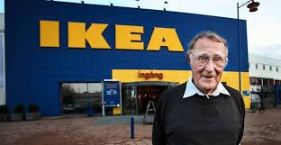
Ingvar Kamprad

Slide 5
IKEA: I Know Everything Already or
Ingvar Kamprad Elmtaryd Agunnaryd
Any job cannot make a person prosperous…. financial growth starts with business
Success and development have no link to education. If education could earn money than all professors of the world would have been billionaires.
There are around 950 billionaires in the world but none of them is a professor, a doctor or an educationalist.
Successful people of the world have a mediocre educational background. These people know the importance of the time so rather than pursuing degrees they start a business in their student life.
There are 30000 people working for IKEA and are far superior to him (Ingvar). These educated people are better than him in vision, knowledge and skills. Deficiency is their lack of courage to quite their jobs and have no faith in their skills
If somone can work for Ingvar so can they do for themselves. All they need is a little courage.
Success is born with feet of an ant but while reaching youth its feet become as big as an elephant's.
There is an alternative for everything but there is no shortcut to success.
No chemical process in the world can transform iron into gold but human hand has the power
There is no refuge for lazy people in the world but it whole world is wide open for the hard working
A person's expertise is his passport.
http://www.forbes.com/billionaires/list/2/#version:static

Slide 6


  ENTREPRENEUR
  A vision-driven individual who assumes significant personal and financial risk to start or expand a business.

Slide 7
What Is An Entrepreneur?
  The pursuit of opportunity through
  innovation, creativity and hard work
  without regard for
  the resources currently controlled.

Slide 8
Entrepreneur: A person who
    Organizes
    Manages
( an enterprise, especially a business)
with considerable initiatives and risks.
  Initiative: Readiness and ability in initiating action.
  Risk: The hazard or chance of loss.

Slide 9
What is an Entrepreneur?
“An entrepreneur is someone who perceives an opportunity and creates an organization to pursue it.“

Slide 10

What is an Entrepreneur?
One who creates a new business in the face of risk and uncertainty for the purpose of achieving profit and growth by identifying opportunities and assembling the necessary resources to capitalize on them

Slide 11
What is an Entrepreneur?
An entrepreneur is someone who is willing to work 16 hours a day to keep from working 8 hours a day for someone else!
Chapter 1 Entrepreneurs
Copyright ©2012 Pearson Education, Inc. publishing as Prentice Hall
1-5

Slide 12
H. Knight and Peter Drucker
Entrepreneurship is about taking risks
Behaviour of the entrepreneur reflects a kind of person who wishes to put his career and financial security on the line
Takes risks in the name of an idea
spending much time as well as capital on an uncertain ventures
D.C. McClelland
Entrepreneurship is doing things in a better way and decision-making under the condition of uncertainty

Slide 13
Peter F. Drucker
An entrepreneur searches for change, responds to it and exploits opportunities.
Innovation is the specific tool of an entrepreneur

Slide 14
Define Entrepreneurship
Harvard Business School
Benjamin Higgins:
Function of,
  Forecasting investment
  Production opportunity
  Organizing an enterprise
  Raising capital
  Hiring labor
Arranging supply chain
Selecting managers for day to day operations
Joseph Schumpeter
A person willing and able to convert new idea /invention to innovation

Slide 15
The World of the Entrepreneur
Every year U.S. entrepreneurs launch 550,000 new businesses.
Entrepreneurial spirit - the most significant economic development in recent history.
GEM study: 18.7% of adult population in the U.S. is actively involved in trying to start a new business.

Slide 16
The World of the Entrepreneur
Every year U.S. entrepreneurs launch 550,000 new businesses.
Entrepreneurial spirit - the most significant economic development in recent history.
Global Entrepreneurship Monitor (GEM) study: 18.7% of adult population in the U.S. is actively involved in trying to start a new business.

Slide 17
The World of the Entrepreneur
Global Entrepreneurship Monitor (GEM) study reports:
  Men are twice as likely to start a business as women.
  Most entrepreneurs turn to family members and friends for capital.
  Entrepreneurs are most likely to launch businesses when they are between the ages of 25 and 44.

Slide 18
Myths about Entrepreneurship
Myth #1: Anyone can start a business.
Myth #2: Entrepreneurs are gambles
Myth #3: Entrepreneurs want the whole show to themselves.
Myth #4: Entrepreneurs are their own bosses and completely independent.
Myth #5: Entrepreneurs work longer and harder than managers in big companies.
Myth #6: Entrepreneurs experience a great deal of stress and pay a high price.
Myth #7: Entrepreneurs are motivated solely by the quest for the almighty dollar.

Slide 19
Myths about Entrepreneurship (cont’d)
Myth #8: Entrepreneurs seek power and control over others.
Myth #9: If an entrepreneur is talented, success will happen in a year or two.
Myth #10: Any entrepreneur with a good idea can raise venture capital.
Myth #11: If an entrepreneur has enough start-up capital, he or she can’t miss.
Myth #12: Entrepreneurs are lone wolves and cannot work with others.
Myth #13: Unless you attained 600 on your SATS or GMATs, you’ll never be a successful entrepreneur.
(Standard Attainment Tests)

Slide 20
Characteristics of Entrepreneurs
Desire for responsibility
Preference for moderate levels of risk – risk eliminators
Confidence in their ability to succeed
Desire for immediate feedback
High level of energy
Future orientation – serial entrepreneurs
Skilled at organizing
Value achievement over money

Slide 21

Benefits of Entrepreneurship
The opportunity to:
Create your own destiny
Make a difference
Reach your full potential
Renap impressive profits
Contribute to society and to
be recognized for your efforts
Do what you enjoy and to h ave fun at it

Slide 22

Drawbacks of Entrepreneurship
Uncertainty of income
Risk of losing your entire investment
Long hours and hard work
Lower quality of life until the business gets established
High levels of stress
Complete responsibility
Discouragement

Slide 23

Feeding the
Entrepreneurial Fire
Entrepreneurs as heroes
Entrepreneurial education
Demographic and economic factors
Shift to a service economy
Technology advancements
Independent lifestyle
E-commerce and the Internet

Slide 24
FIGURE 1.3 U.S. Retail E-Commerce Revenues Source: Based on Forrester Research, 2008.

Slide 25
Entrepreneurship
One characteristic of entrepreneurs stands out:
Diversity!
Anyone – regardless of age, race, gender, color, national origin, or any other characteristic – can become an entrepreneur (although not everyone should).

Slide 26

The Cultural Diversity of Entrepreneurship
Young entrepreneurs

Slide 27
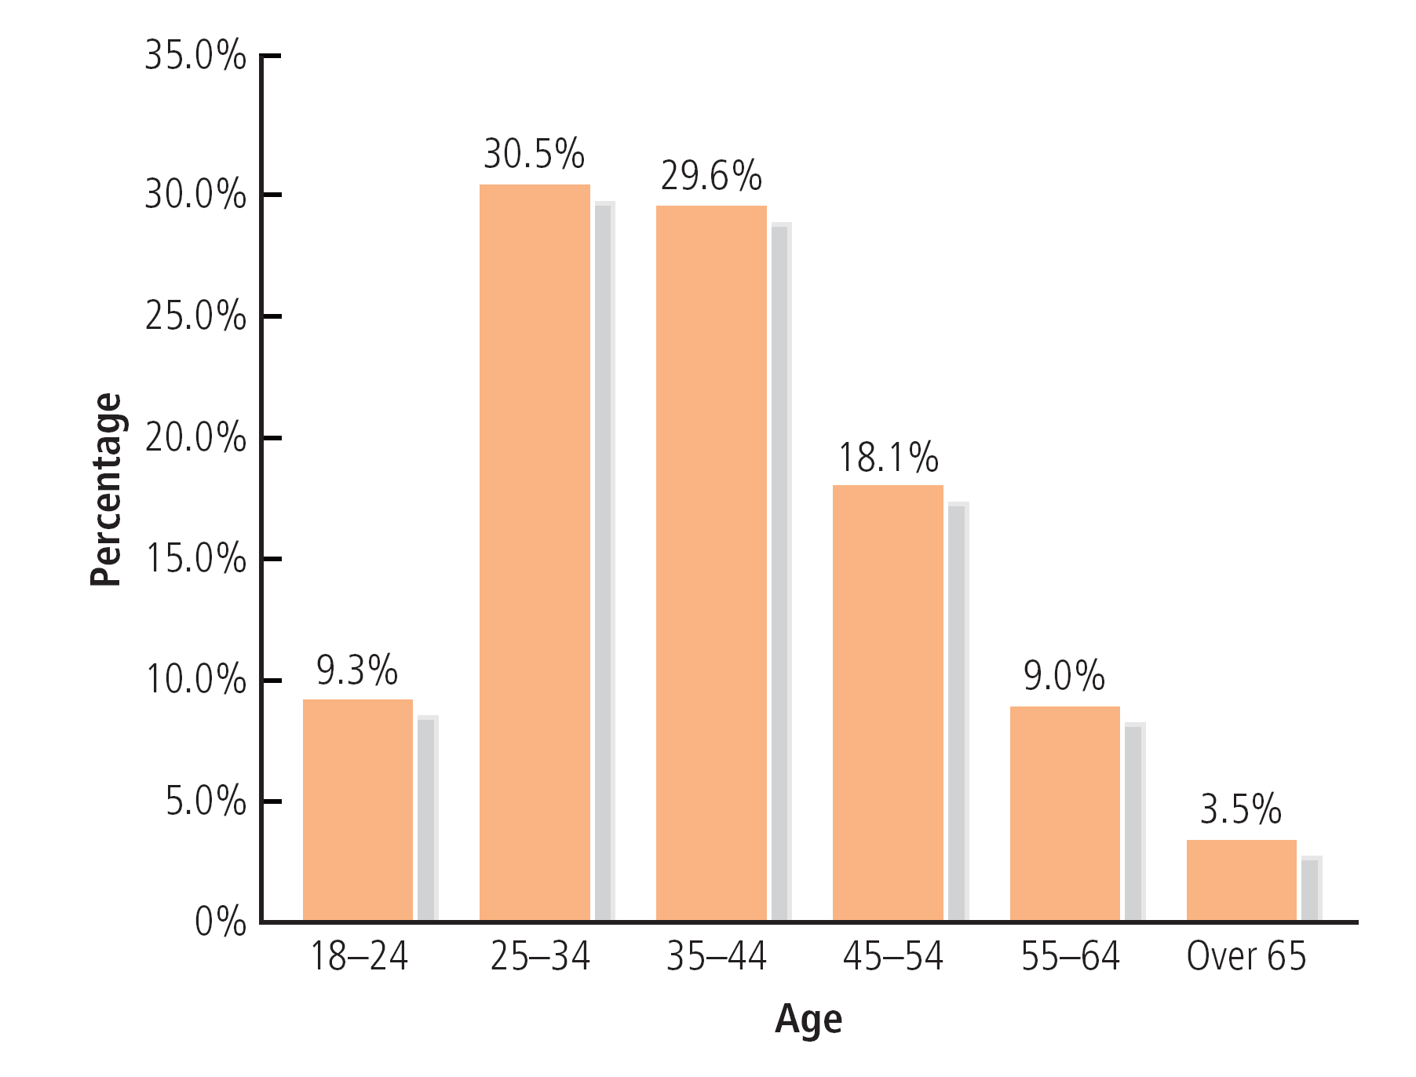

Slide 28
The Cultural Diversity of Entrepreneurship
(continued)
Young entrepreneurs
Women entrepreneurs

Slide 29
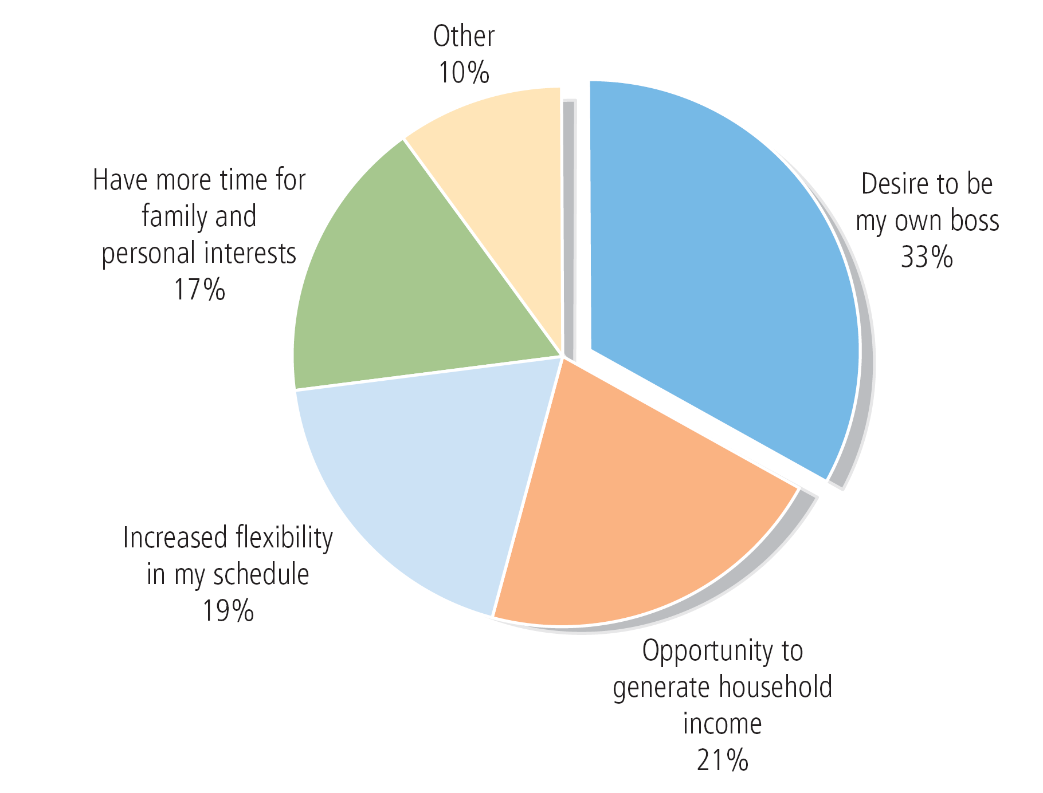
FIGURE 1.4 Why Women Start Businesses
Source: U.S. Small Business Administration, 2007.

Slide 30

The Cultural Diversity of Entrepreneurship
(continued)
Young entrepreneurs
Women entrepreneurs
Minority-owned enterprises
Immigrant entrepreneurs
Part-time entrepreneurs

Slide 31
The Cultural Diversity of Entrepreneurship
(continued)
Home-based businesses
Family businesses
Copreneurs*
Corporate castoffs
Corporate dropouts
Social entrepreneurs
Retiring Baby Boomers
Husbands and wives or couples with marital or marital-like relationships working together in the same business
individuals who are unemployed and are highly educated, skilled and had corporate executive jobs
Dramatic downsizing of corporate for restructuring---lead to trust gap.-- growing number of dropouts from the corporate structure
There are about 76 million Baby Boomers in the United States

Slide 32
Retiring Baby Boomers
There are about 76 million Baby Boomers in the United States
More than 40 million are already age 65 or older
As a generation, they have shaped and altered every life stage
Will retire at a rate of 10,000 per day through at least 2030
In 2030, almost 73 million Americans, comprising more than 20 percent of the U.S. population, will be age 65 or older.

Slide 33
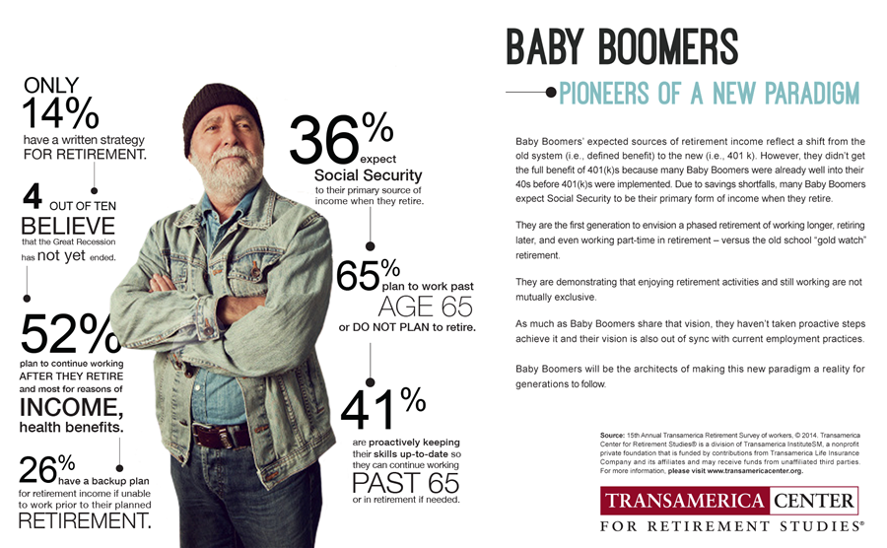

Slide 34
Small Businesses ...
Make up 99.7% of the 30.14 million businesses in the U.S.
Employ 51% of the nation’s private sector workforce.
Create more jobs than big businesses.
  60% to 80% of net new jobs over the last decade
Are leaders in offering training and advancement opportunities to workers.

Slide 35

Small Businesses ...
(continued)
Produce 51% of the nation’s private GDP.
Account for 47% of business sales.
Create 13 times more patents per employees than large companies.
Zipper, light bulb, FM radio, laser, air conditioning, escalator, personal computer, automatic transmission, and many more!
gross domestic product (GDP) is one of the primary indicators used to gauge the health of a country's economy. It is total dollar value of all goods and services produced over a specific time period. It shows size of the economy.

Slide 36
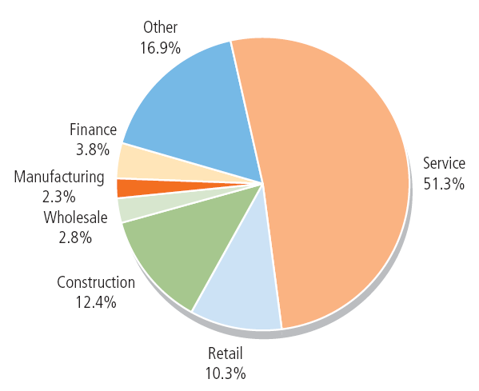
FIGURE 1.5 Small Business by Industry
Source: U.S. Small Business Administration, 2007.

Slide 37
Ten Deadly Mistakes of Entrepreneurship
Management mistakes
Lack of experience
Poor financial control
Weak marketing efforts
Failure to develop a strategic plan

Slide 38
Ten Deadly Mistakes of Entrepreneurship
Uncontrolled growth
Poor location
Improper inventory control
Incorrect pricing
Inability to make the “entrepreneurial transition”

Slide 39
Putting Failure Into Perspective
Entrepreneurs are not paralyzed by the prospect of failure.
Failure – a natural part of the creative process.
Successful entrepreneurs learn to fail intelligently.

Slide 40
Avoiding the Pitfalls of
Small Business Failure
Know your business in depth
Develop a solid business plan
Manage financial resources
Understand financial statements
Learn to manage people effectively
Set your business apart from the competition
Maintain a positive attitude

Slide 41
Why People Become Entrepreneurs
Reluctant Entrepreneur
  A person who becomes an entrepreneur as a result of some severe hardship.
Refugee
  A person who becomes an entrepreneur to escape an undesirable situation.

Slide 42
Artisan Entrepreneurs
Artisan Entrepreneur
  A person with primarily technical skills and little business knowledge who starts a business
Characteristics:
  Take a paternalistic/authoritarian approach
  Are reluctant to delegate
  Use few sources of capital
  Have a traditional marketing strategy
  Focus on personal sales effort
  Have a short planning horizon

Slide 43
Opportunistic Entrepreneurs
Opportunistic Entrepreneur
  A person with both sophisticated managerial skills and technical knowledge who starts a business
Characteristics:
  Broad-based education
  Scientific approach to problems
  Willing to delegate
  Broad view of strategy
  Diversified marketing approach
  Longer planning horizon
  Sophisticated accounting
  and financial control

Slide 44
Would-be entrepreneurs
“Would-be entrepreneurs who are unable to name customers are not ready to start a business. They have only found an idea and have not yet identified a market need.”

Slide 45
What Does it Take to Be Successful?
“In entrepreneurship, luck is where preparation and opportunity meet.”

Slide 46
What Does It Take to Be Successful?
The idea is not what is important
In entrepreneurship; ideas are a dime a dozen.
important things are,
  Developing the idea
  implementing it
  building a successful business

Slide 47
What Does It Take to Be Successful?
Somehow, someday… you are going to have to earn
POSITIVE CASH FLOW.

Slide 48
The Importance of Value Creation
A successful business is one that delivers value to its customers and creates value for its owners.

Slide 49
The Importance of Value Creation
Value is delivered to your customers when you do something for them
    Better
    Cheaper
    Faster
    Cooler
    Different
  However, it is likely that none of these will work for long, so continuous improvement and innovation are essential.

Slide 50
The Importance of Value Creation
Value is created for the owners when:
  You do more with their money than they could do with it themselves
  You invest in productive activities that earn rates of return greater than their risk-adjusted costs of capital.

Slide 51
The Importance of Value Creation
Value is created by:
  Exploiting proprietary physical resources
  Possessing proprietary knowledge or expertise
  Creating a new or improved product, process, or service
  Staying ahead of the competition through constant improvement and innovation

Slide 52
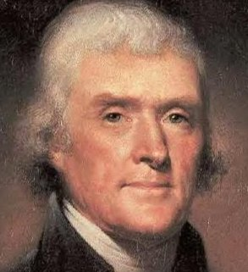
Closing Thoughts
“I find that the harder I work, the more luck I seem to have.” Thomas Jefferson
(American Founding Father who was principal author of the Declaration of Independence.
He was elected the second Vice President of the United States and the third President)

Slide 53
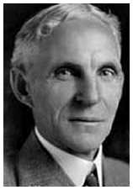
Closing Thoughts
“Whether you think you can, or that you can’t, you are usually right.” Henry Ford

Slide 54
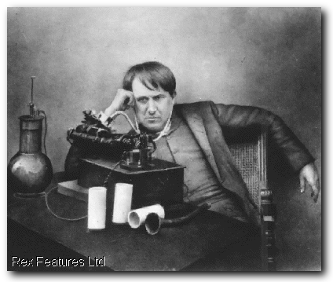
Closing Thoughts
“I have not failed. I have just found 10,000 ways that won’t work.” Thomas Edison
American inventor and businessman
America's greatest inventor
Developed many devices, phonograph, the motion picture camera, practical electric light bulb

Slide 55
Entrepreneurs: Born or Made?
Is there inborn talent required?
Assume that the answer is YES:
  then we can identify the main characteristics
  if we have them, fine - no others need to apply!
  we could start spotting talent in kindergarten
  we could "stream" these people
  we could discourage people without these talents

Slide 56
Entrepreneurs: Born or Made?
Assume the answer is NO:
  then schools could teach anyone
  would be a "profession" like law or medicine
  companies could establish "nurseries" for them
  government "incubators" would be successes
The real answer lies somewhere in-between
  Talent and education

Slide 57
Who is an Entrepreneur?
Future Goals
Change
Status Quo
Possible
Entrepreneur
Satisfied
manager
Perceived
Capability
Blocked
Frustrated
manager
Classic
bureaucrat

Slide 58
Women Entrepreneurs
More Women Entrepreneurs
  More women than men are starting new businesses
  40% of all businesses are now majority female-owned
  Movement of women into nontraditional industries
Problems Facing Female Entrepreneurs
  Discrimination and difficulties
  related to gender
  Lack of access to credit
  Lack of networking connections
  Balancing work and family life

Slide 59
Women as Entrepreneurs
2 Main Types
  Traditional Activities
    Typically older, modestly educated women involved in traditional manufacturing and trading (perfume mixing, cloth-making, handicrafts).
  Modern Activities
    Typically managed by younger, well-educated, business oriented.
    Use of advanced information + communication techniques in more modern economic activities.
Source: Erogul & McCrohan, 2007.
Notes:
Erogul, M & McCrohan, D. (2007). Socio-Cultural Factors Inhibiting Female Entrepreneurship in the United Arab Emirates. College of Business Sciences, Zayed University, Dubai, UAE

Slide 60
Women Entrepreneurs tend to earn less due to
  Types of industries women often operate in offer lower returns on investments.
  Fewer number of total hours worked due to other commitments.
  Small amount of capital women are able to raise to initially finance their business.

Slide 61
Women & Entrepreneurship
A global study on Entrepreneurs found the UAE to have an extremely low female participation rate, relative to other participating countries in both startup/young and established businesses.
  Men are 20x as likely as women to be involved in a startup or young business venture.
McCrohan, D & Preiss, K, 2006; Erogul, M & McCrohan, D, 2007.
Notes:
McCrohan, D & Preiss, K. (2006). Mohammed Bin Rashid Establishment for Young Business Leaders- GEM United Arab Emirates: Entrepreneurship in the United Arab Emirates in 2006. College of Business Science, Zayed University,
Erogul, M & McCrohan, D. (2007). Socio-Cultural Factors Inhibiting Female Entrepreneurship in the United Arab Emirates. College of Business Sciences, Zayed University, Dubai, UAE

Slide 62
Pakistani Women Entrepreneurships

Slide 63
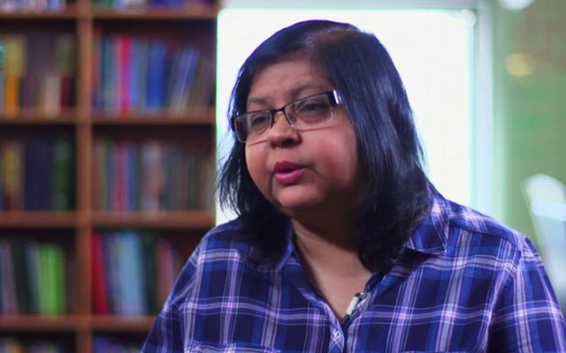
Jehan Ara---- Pakistan Software Houses Association) PASHA
She is the active president and the mastermind behind PASHA (Pakistan Software Houses Association)
The company that focuses on IT by providing software products and services is the brainchild

Slide 64
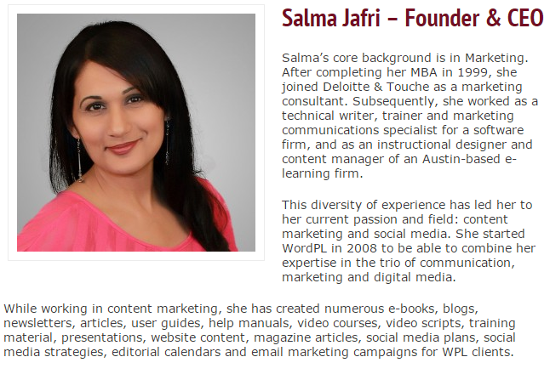

Slide 65
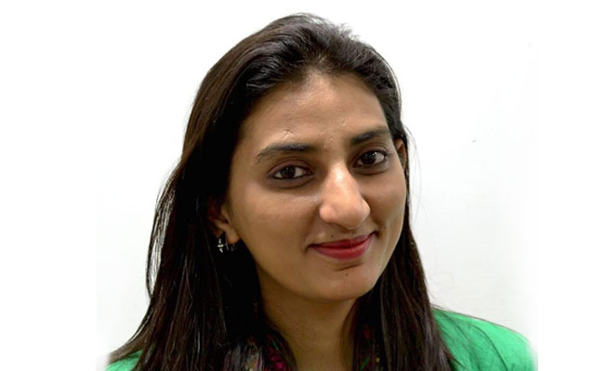
Sidra Qasim:-- co-founder of home town Shoes company
Introduced the handcraft shoes on the internet
Now known as Markhor.
It is an exceptional portal which sells handcrafted shoes of Pakistani craftsmen to the world.
The firm has got enough recognition as Sidra has major buyers from Europe,

